Slide 1
Predicting Building Permit Issue Time
David Tse
Springboard Capstone Project 1
September 3, 2018

Slide 2
Project Motivation
Building permit issue times
Potentially increases construction project schedules
Financial risk if projects not completed on time
Few general guidelines given from city building departments
Typically require building expeditors to hasten permit issue times

Slide 3
Potential Client Use Cases
Real Estate Developers: optimize their project portfolio to consider reduced construction project timelines
Homeowners: obtain more accurate time estimates for permitting and reduce reliance on anecdotal advice from building contractors/building department.
NYC Building Permit Officials: triage requests to potentially reduce response turnaround time.

Slide 4
Data Wrangling and Cleaning
Sourced from NYC OpenData
CSV file: 60 columns and over 3.37M records
Filter date range from May 9th 2012 to May 9th, 2018
Cleaning:
Outliers: Removed negative issue times
Missing Data: Marked as NaN, or removed if # of missing records is <5% of total #
Out of Scope: features with extremely high cardinality (e.g. address) or optional fields with a majority of missing values
Feature Engineering:
Dependent variable:
Continuous: Issue time (days) = issuance date - filing date
Binary: 1 to 3 months or over 3 months
Extracted day and month information from temporal data

Slide 5
Summary Statistics

Slide 6
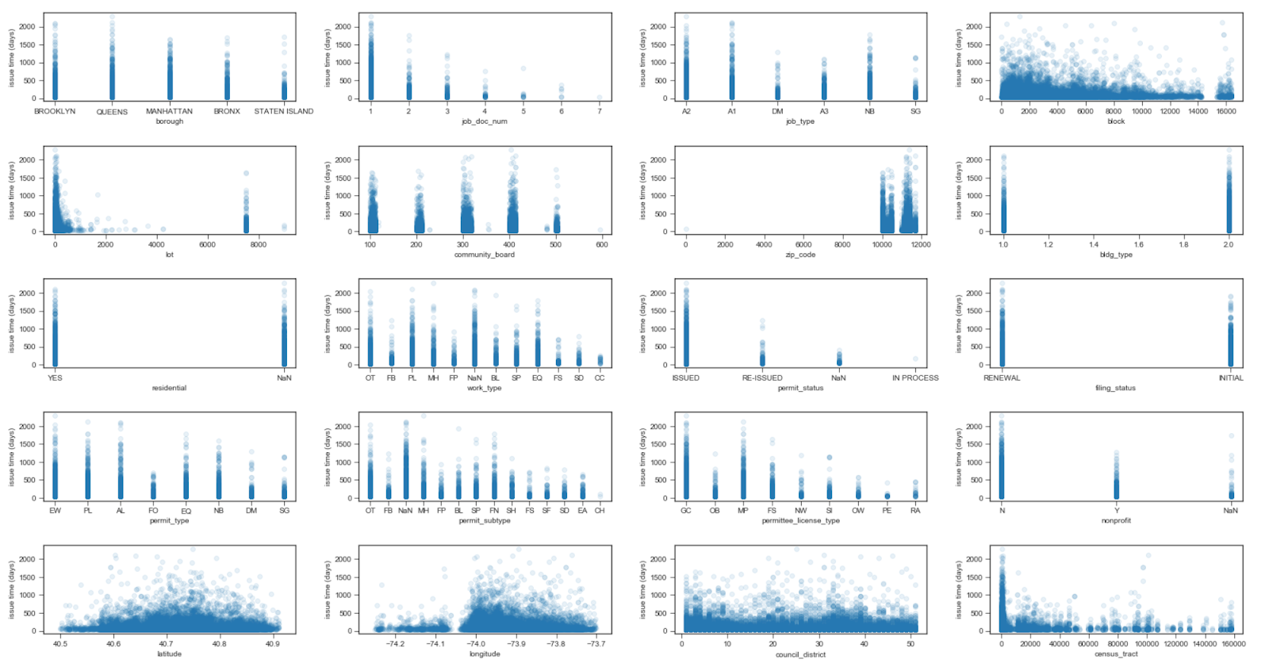
Independent Variables vs. Issue Time

Slide 7
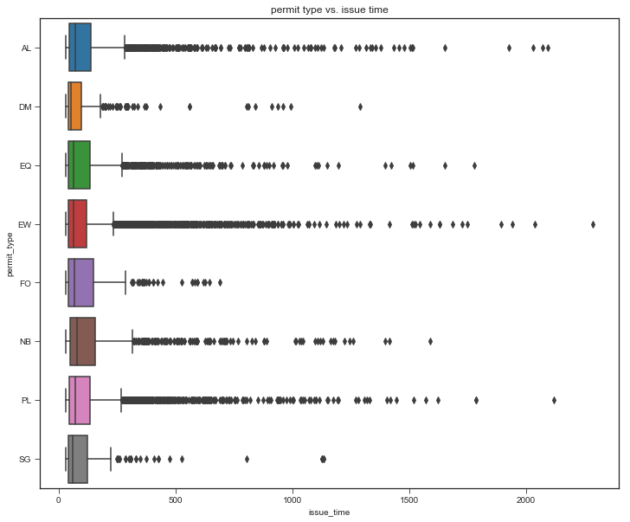
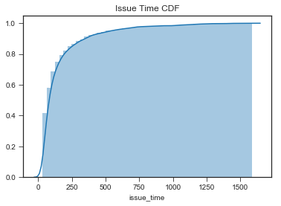
Heavy Right Skewness of Data

Slide 8
Building Permit Issue Time Heat Map
Neighborhoods with high activity:
Brooklyn: Park Slope, Bushwick, Brighton Beach, Williamsburg
Manhattan: Majority of neighborhoods
Queens: Flushing, Jackson Heights, Elmhurst, Astoria, College Point
Bronx: N/A
Staten Island: N/A

Slide 9
Framing the Machine Learning Problem
Classification or Regression?
Use Binary Classification as a starting point:
fewer assumptions to be satisfy
Still provides value to the end user
Easier to address class imbalance issues given heavy right skew in data
Which metrics to use?
AUC of ROC Curve
F1-score
Result Interpretability

Slide 10
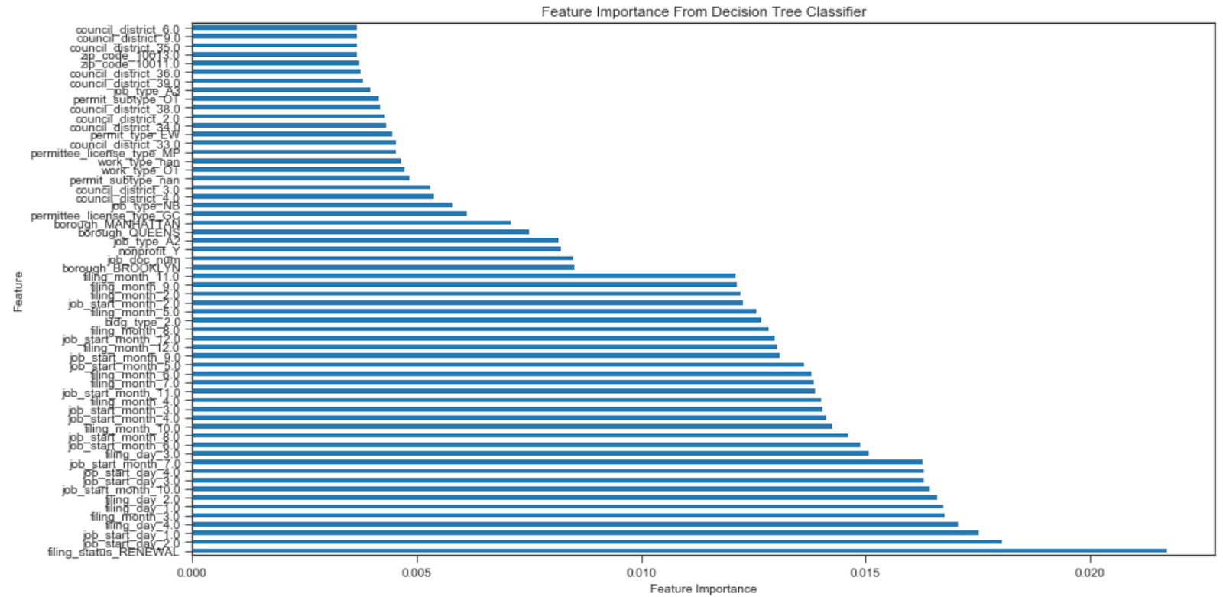
Feature Importance
Top Feature Types:
Temporal
Location
Work Type

Slide 11
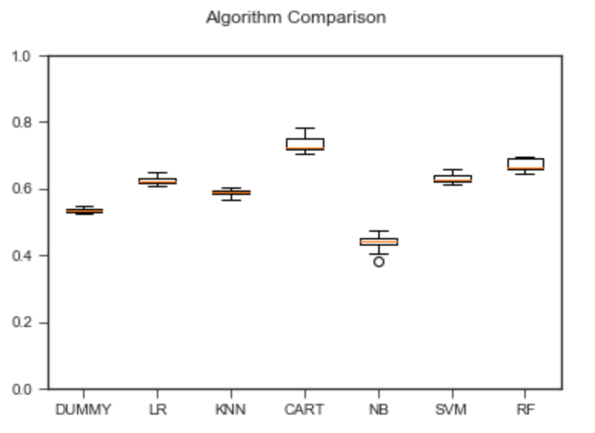
Initial Machine Learning Algorithm Comparison
DUMMY = Dummy Classifier
LR = Logistic Regression
KNN = K-Nearest Neighbors
CART = Classification & Regression Trees
NB = Naïve Bayes
SVM = Support Vector Machine with RBF
RF = Random Forest
Accuracy
Algorithm
Focus on tree-based algorithms

Slide 12
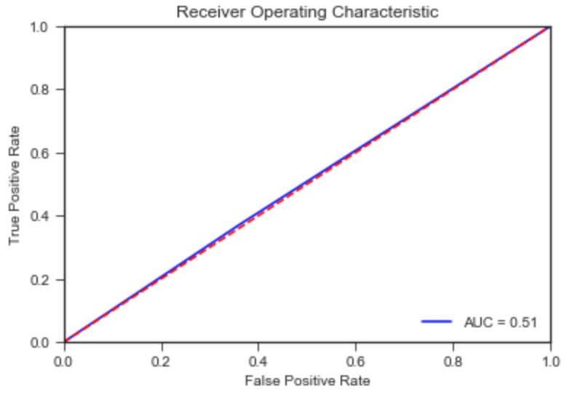
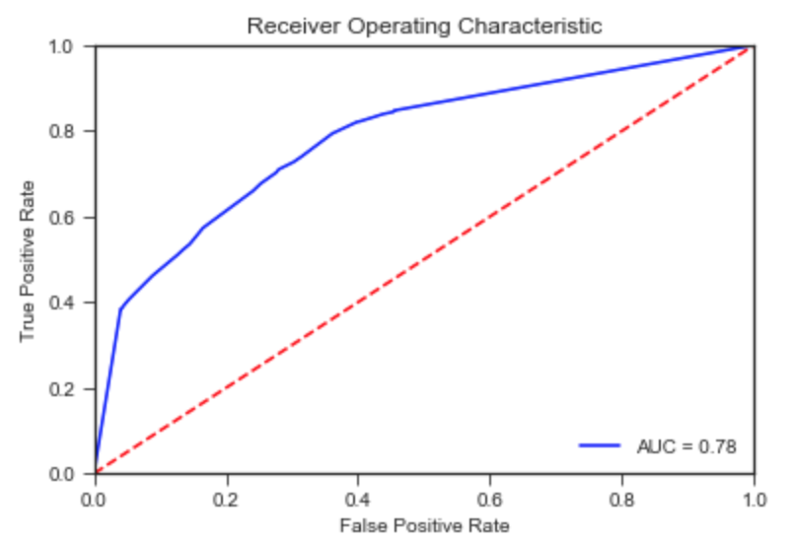
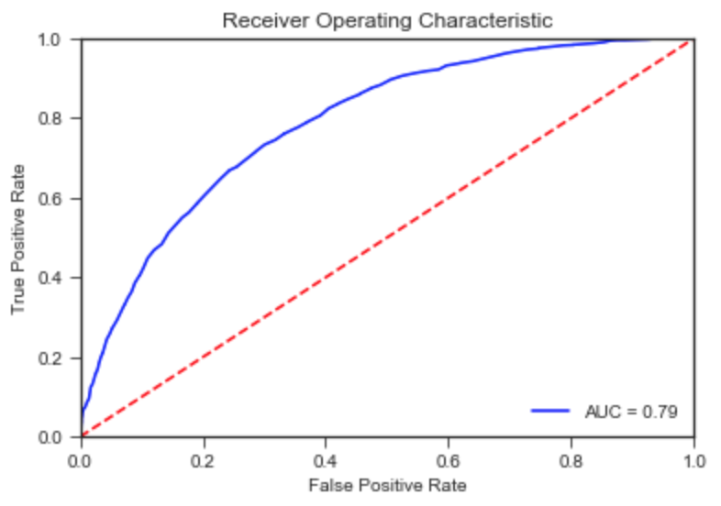
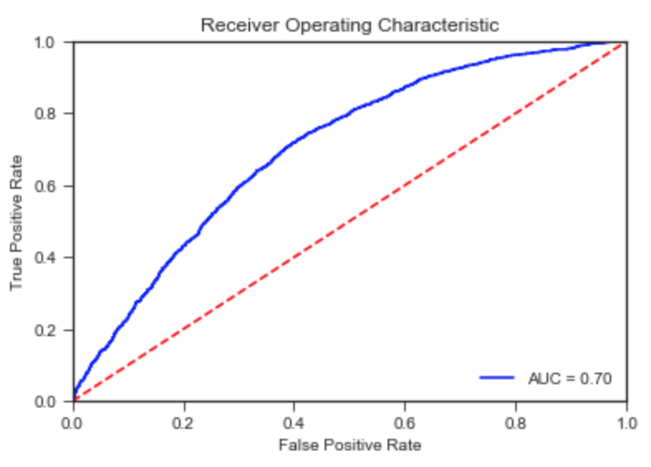
Optimized Machine Learning Models
 | Optimized Hyperparameters | F-1 Score | ROC Curve AUC
Dummy | N/A | 0.53 | 0.51
Decision Tree | 'max_depth': 75, 'min_samples_leaf’: 4 | 0.73 | 0.78
Random Forest | 'max_depth': 150, 'min_samples_leaf’: 1 'n_estimators': 150 | 0.67 | 0.79
Gradient Boosted Tree | 'n_estimators': 200 | 0.55 | 0.70
Provides interpretability with decision stumps, fairly high AUC and robustness against outliers

Slide 13
Recommendations
Real Estate Developers/ Homeowners:
Location, time and work/permit type are some of the most important features in building issue times.
Use the Random Forest/Decision Tree algorithm to predict building permit issue time categories of 3 months or greater than 3 months for non-trivial work items, e.g. new buildings and major alterations that will change the use, egress, or occupancy of the building.
For minor work, such as electrical work and demolition, involving single building departments expect issue times of less than a month.
NYC Building Department:
Provide a web service that allows applicants to take an online survey.
Survey generates building permit issue time range based on data from the past 5 years based on the Random Forest algorithm.

Slide 14
Limitations and Future Work
Limitations:
The building permit data did not include the cost of the proposed work.
Building permit expeditors typically reduces turnaround time for permit applications, which may introduce bias into the dataset.
Future Work:
Investigate framing the problem into a multi-class problem.
Try incorporating other related datasets that may boost the signal, such as population and household income datasets to better understand why location is a strong predictor.

Slide 15
Acknowledgements
Springboard staff and community
My mentor, Scott Clendaniel
NYC OpenData

